Slide 1
tkinterda rasm chizish. Canvas moduli

Slide 2
Canvas
Tinkterda rasm ob'yektlari Canvas sinfiga asoslanib yaratiladi, unga turli shakllarni joylashtirishingiz mumkin. Buning uchun tegishli usullarni chaqirish mumkin.
Canvas ning nusxasini yaratishda uning kengligi va balandligini aniqlash lozin. Geometrik shakl va boshqa ob'ektlarni joylashtirganda ularning koordinatalari Canvasda ko'rsatilgan bo`lishi shart.
Koordinataning boshlanish nuqtasi yuqori chap burchak.

Slide 3
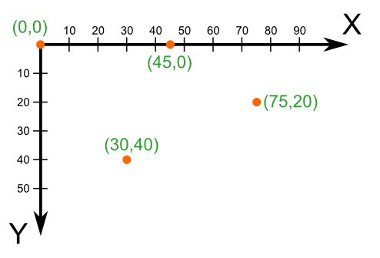

Slide 4
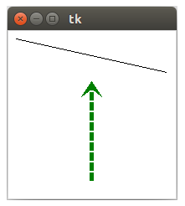
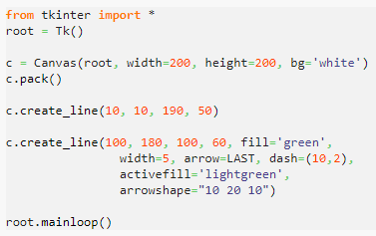
create_line()
Kesmalar create_line () usuli yordamida chiziladi. Koordinatalari (x1, y1), so'ngra (x2, y2) beriladi.

Slide 5
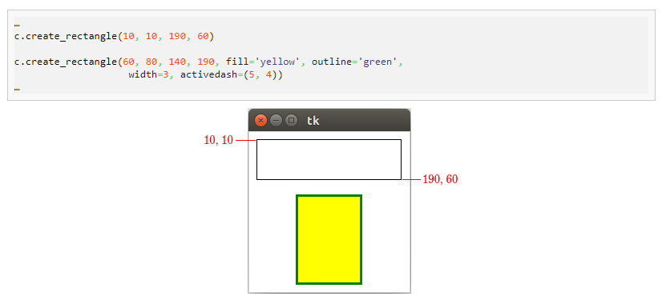
create_rectangle()

Slide 6
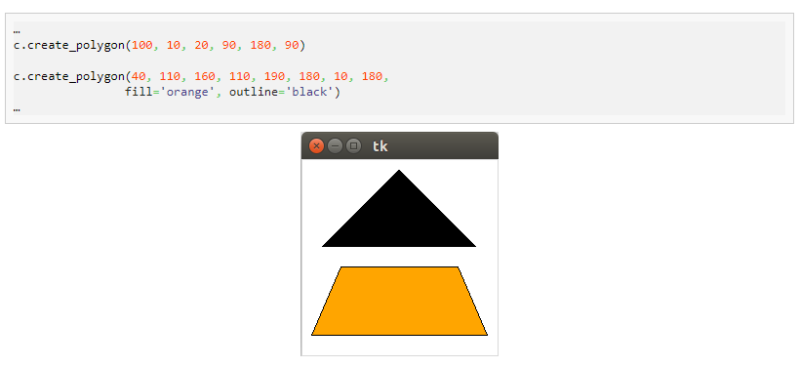

create_polygon()

Slide 7
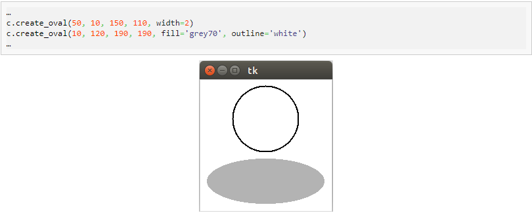
create_oval()

Slide 8
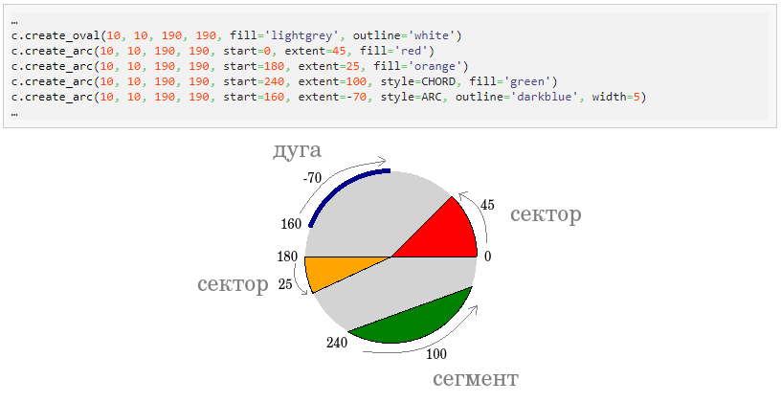
create_arc()

Slide 9
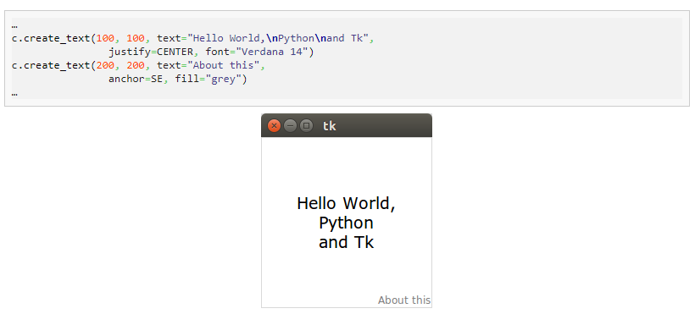
create_text()

Slide 10
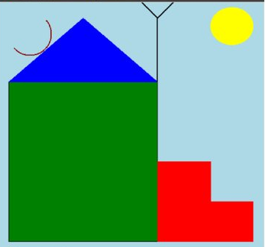

Slide 11
1. Bo'sh dasturda tkinter shablonni yozish
from tkinter import *
root=Tk()
root.title(‘Rasmga misol ')
# code
root.mainloop()

Slide 12
Chizish uchun Canvas yaratish
canv=Canvas(root,width=500,height=500,bg="lightblue",cursor="pencil")
root - ota-ona oynasi
width, height- Canvasning kengligi va balandligi,
bg - fon rangi,
cursor - kursor turi.

Slide 13
3. Yashil to'rtburchak chizish:
canv.create_rectangle(20,150,300,450,fill="green",outline="black")
20,150 - to'rtburchakning chap burchagining X va Y ni,
300,450 - to'rtburchakning pastki o'ng burchagidagi X va Y ni belgilaydi,
fill - rangni to'ldirish
outline - chiziqlar rangi (kontur).

Slide 14
4. Shiferni chizish
canv.create_polygon([20,150],[160,30],[300,150],fill="blue",outline="blue")

Slide 15
5. Zinalarni chizish
canv.create_polygon([300,450],[300,300],[400,300],[400,375],
[480,375], [480,450],
fill="red",outline="red")

Slide 16
6. Quyoshni chizish
canv.create_oval(400,10,480,80,fill="yellow",outline="yellow")

Slide 17
7. Antenani chizish
canv.create_line(300,150,300,30,width=2,fill="black")
canv.create_line(300,30,270,0,width=2,fill="black")
canv.create_line(300,30,330,0,width=2,fill="black")

Slide 18
8.Suputnik antenani chizish
canv.create_arc([20,20], [100,100],
start=220,extent=180,style=ARC,
outline="darkred",width=2)

Slide 19
9. Matn yozish
canv.create_text(20,470,
text=“Dacha",font="Verdana 12", anchor="w",
justify=CENTER,
fill="darkblue")

